Slide 1
CSET335L (Deep Learning)
Lecture 10: Bias Variance
Deepika Vatsa

Slide 2
Outline
Regularization techniques: Drop out, Early stopping
Bias
Variance

Slide 3
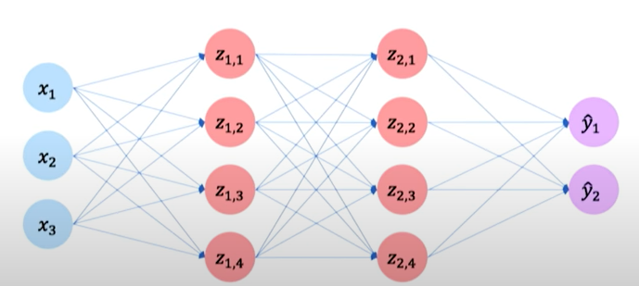
Regularization: Drop Out
Very popular regularization method in deep learning is drop out
During training, randomly select some activations in hidden layers and set it to 0.
Notes:
So we are telling our network to not rely on those neurons too much.

Slide 4
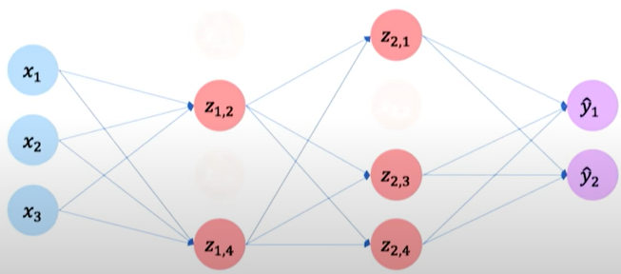
Regularization: Drop Out
Lets say if drop out is 50% (dropping 50% activation neurons), then at different iterations, we randomly select different 50% activations to drop.
Notes:
It helps in learning different pathways in our network which will further help to generalize the model.

Slide 5
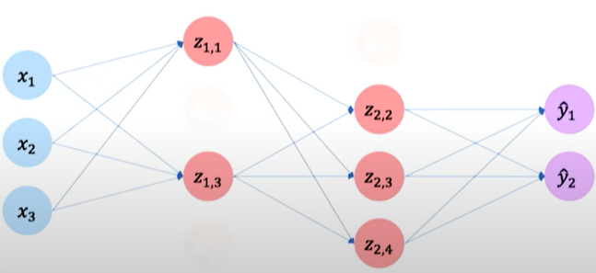
Regularization: Drop Out
Lets say if drop out is 50% (dropping 50% activation neurons), then at different iterations, we randomly select different 50% activations to drop.
Notes:
It helps in learning different pathways in our network which will further help to generalize the model.

Slide 6
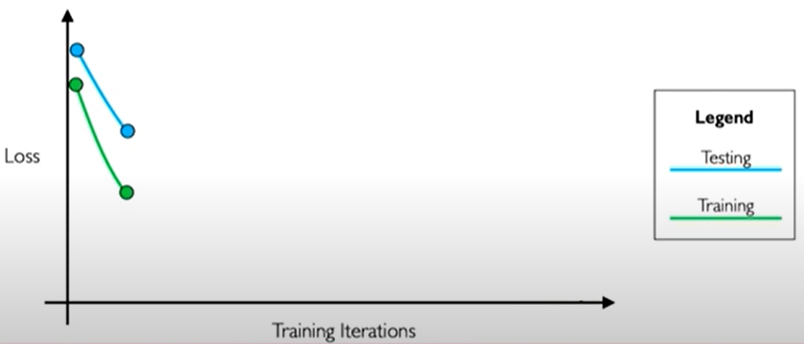
Regularization: Early Stopping
Overfitting also happens when there is too much training.
Solution: Stop training before we have a chance to overfit.
Notes:
We know in overfitting, our model performs very good on training data but very badly on our test data. So in this case of regularization, what we do is we create a small set from training and call it our example test set. So initially our model works good on both training and test set (that is loss decreases), but after certain num of iterations it increases for test set while decreases for the training set. The pattern of divergence continue for further training iterations. We will figure out a point where the test loss is minimum and we will stop there. That would be the best model for generalization.

Slide 7
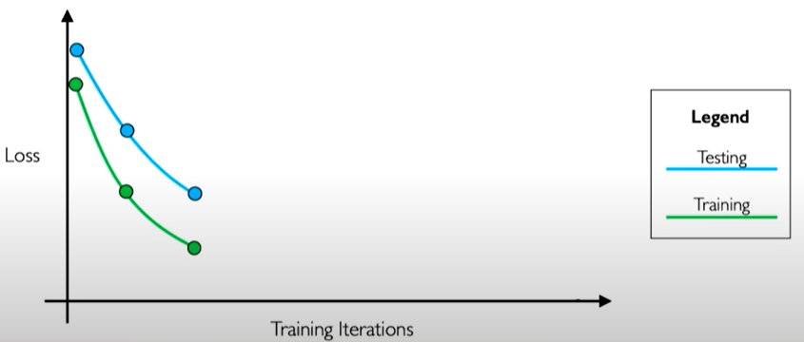
Regularization: Early Stopping
Stop training before we have a chance to overfit
Notes:
We know in overfitting, our model performs very good on training data but very badly on our test data. So in this case of regularization, what we do is we create a small set from training and call it our example test set. So initially our model works good on both training and test set (that is loss decreases), but after certain num of iterations it increases for test set while decreases for the training set. The pattern of divergence continue for further training iterations. We will figure out a point where the test loss is minimum and we will stop there. That would be the best model for generalization.

Slide 8
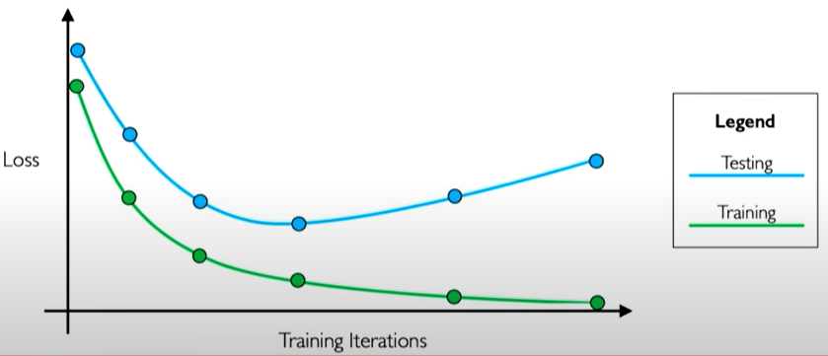
Regularization: Early Stopping
Stop training before we have a chance to overfit
Notes:
We know in overfitting, our model performs very good on training data but very badly on our test data. So in this case of regularization, what we do is we create a small set from training and call it our example test set. So initially our model works good on both training and test set (that is loss decreases), but after certain num of iterations it increases for test set while decreases for the training set. The pattern of divergence continue for further training iterations. We will figure out a point where the test loss is minimum and we will stop there. That would be the best model for generalization.

Slide 9
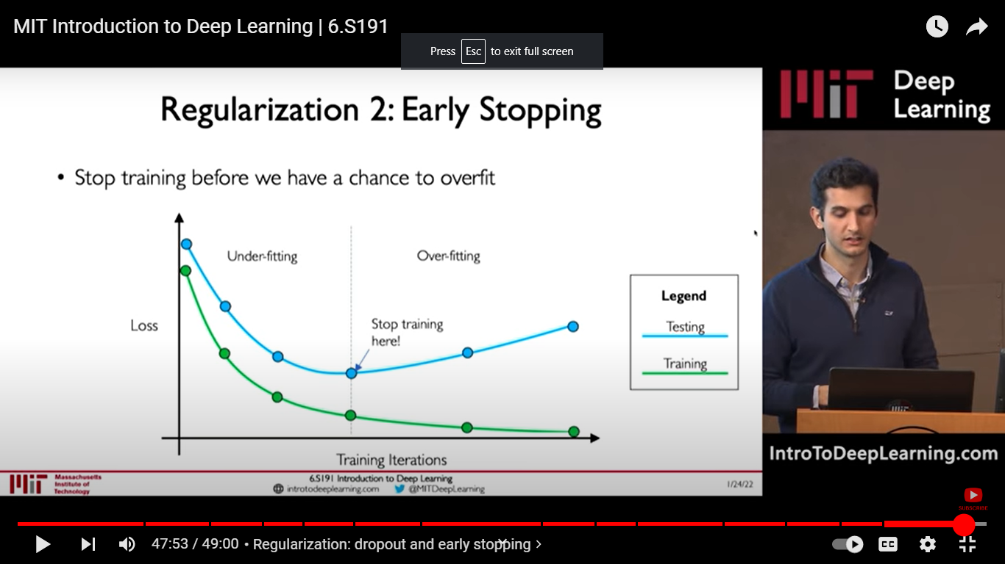
Regularization: Early Stopping
Stop training before we have a chance to overfit
Notes:
We know in overfitting, our model performs very good on training data but very badly on our test data. So in this case of regularization, what we do is we create a small set from training and call it our example test set. So initially our model works good on both training and test set (that is loss decreases), but after certain num of iterations it increases for test set while decreases for the training set. The pattern of divergence continue for further training iterations. We will figure out a point where the test loss is minimum and we will stop there. That would be the best model for generalization.

Slide 10
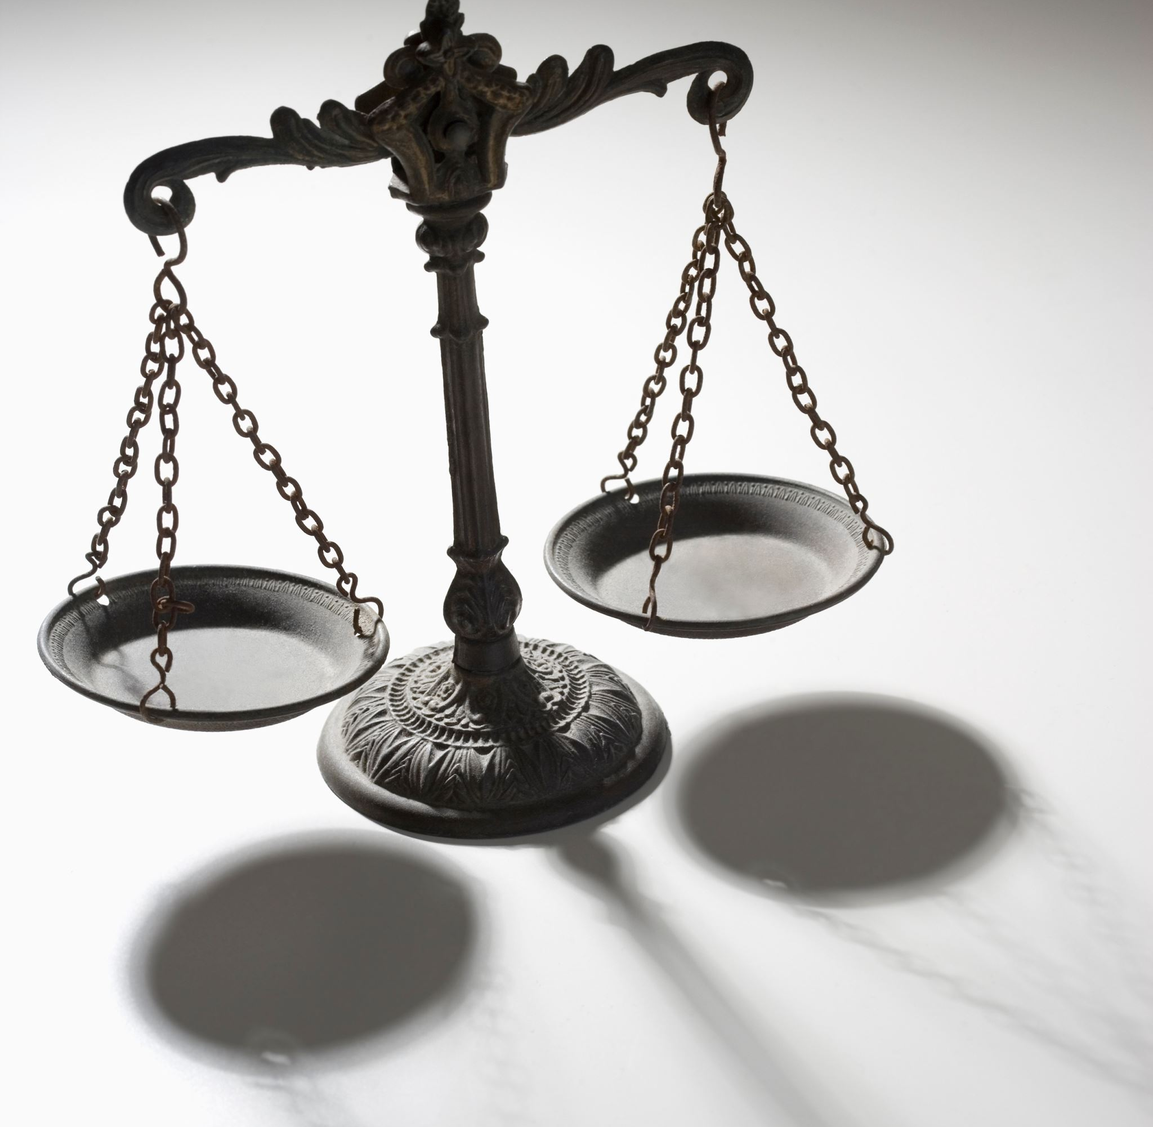
Bias and Variance
Notes:
High bias means high training error

Slide 11
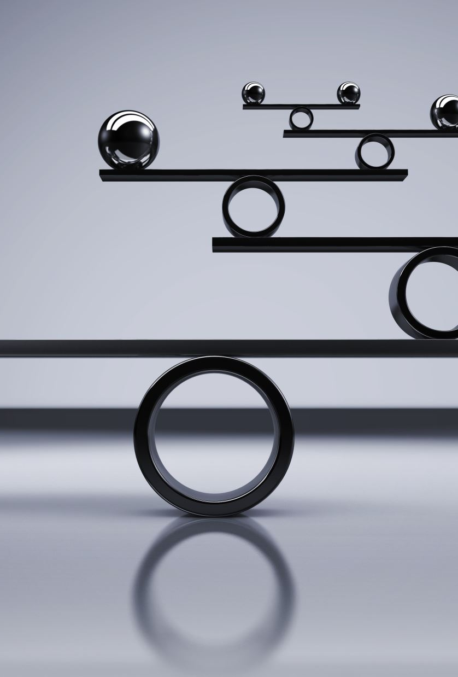
Bias and Variance at Model level
Notes:
High bias means high training error

Slide 12
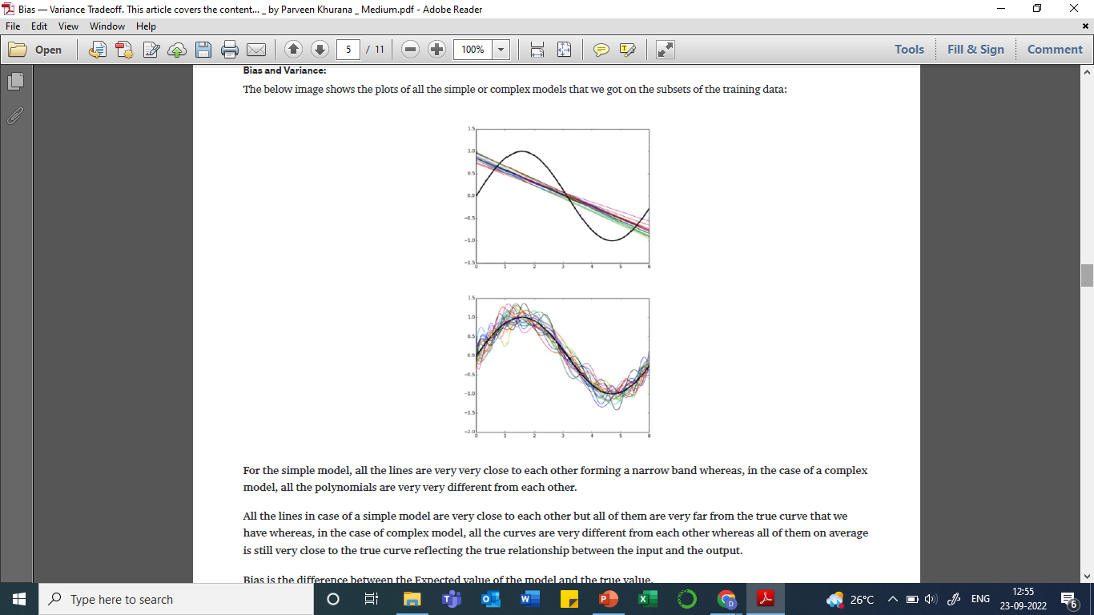
Bias (at model level)
Bias is the difference between the average prediction of our model and the correct value that we are trying to predict.
Left Graph: Simple models trained on multiple subsets of training data.
Right graph: Complex models trained on multiple subsets of training data.
Notes:
High bias means high training error

Slide 13
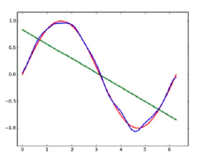
Bias (at model level)
Bias is the difference between the average prediction of our model and the correct value that we are trying to predict.
Green line: Average prediction of simple models
Blue line: Average predictions of complex models
Red line: Actual curve of data points
Green line far from actual curve -> High bias
Blue line is close to the actual curve -> Low bias
Notes:
High bias means high training error

Slide 14
Bias (at model level)
Bias is the difference between the average prediction of our model and the correct value that we are trying to predict.
Model with high bias pays very little attention to the training data -> underfit model
Oversimplified model.
It always leads to a high error on training and test data.
Simple model = High bias = High training error
Notes:
High bias means high training error

Slide 15
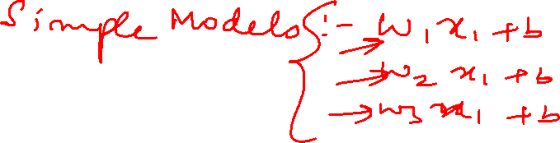

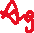
Variance
Variance is how our model prediction varies for a given data point
Expected/Average predictions of simple model will be close to the actual prediction of any one simple model, variance of the model is small.
Expected/Average predictions of complex models will not be close to the actual prediction of any one complex model, variance of the model is high.

Slide 16
Variance
Variance is how our model prediction varies for a given data point
Model with high variance pays a lot of attention to training data and does not generalize on the test data -> Overfit model
Such models perform very well on training data but have high error rates on test data.
Complex model = High variance = high test error

Slide 17
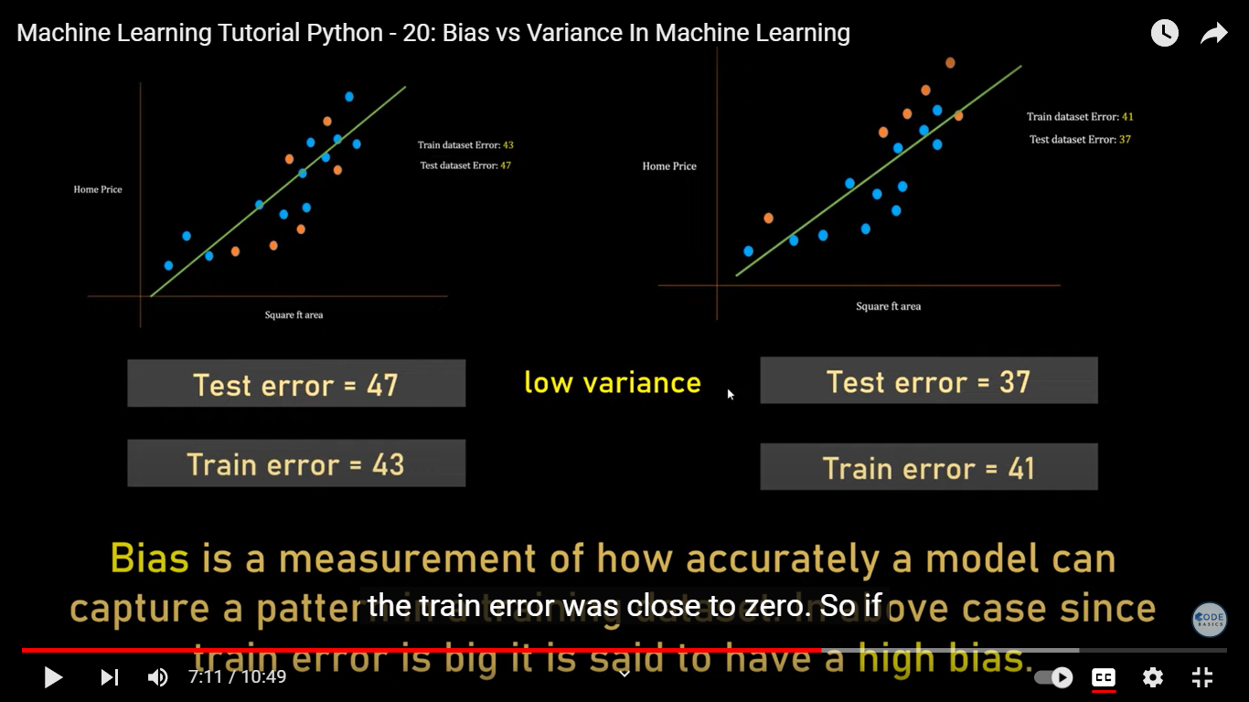






Example of underfitting and high bias
Notes:
Here blue points are training data points and orange points are test data points
The difference in the test error is low while the train error is high, therefore high bias.

Slide 18
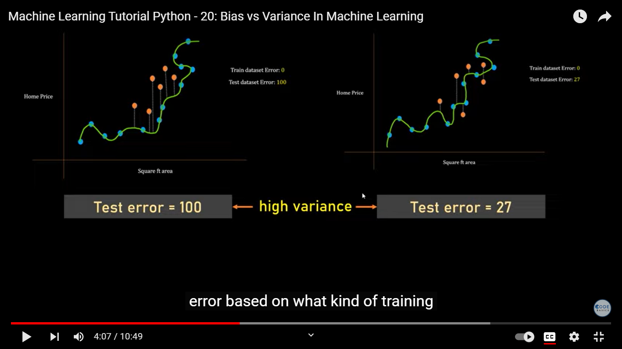

Example of overfitting and high variance
Notes:
We know in case of overfitting, train error is low and test error is high.
Here since our model is overfit, test error varies greatly depending upon the selection of training samples.
In one selection, test error is 100, while in another, test error is 27.
So when training samples are selected at random, the test error varies randomly as well.
High variance is a common issue with overfit models. Here, high variance means high variability in test error.
Low bias because train error is 0

Slide 19
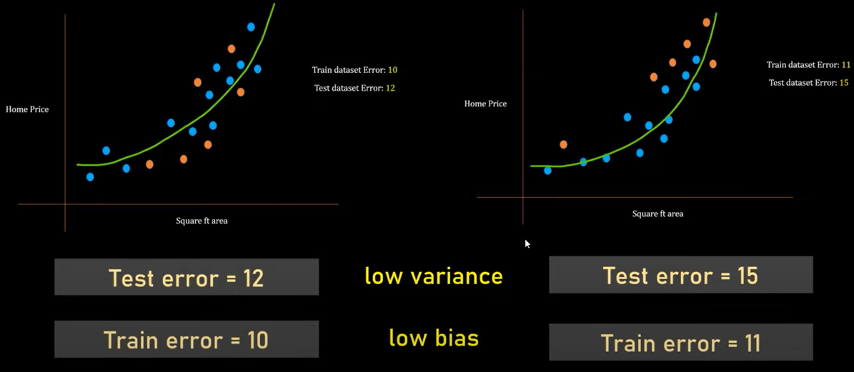
Example of balanced fit, low variance and low bias

Slide 20
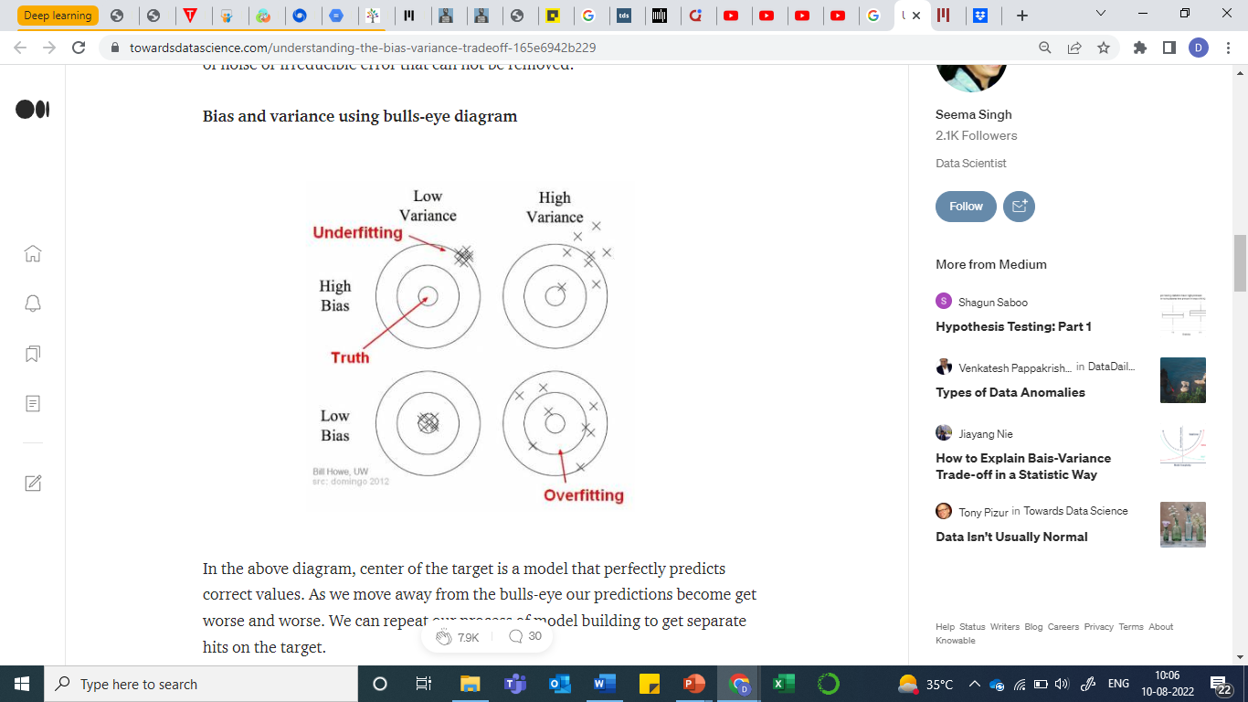

Bias and Variance using Bull’s eye diagram
Notes:
Here variance means variation in test error

Slide 21
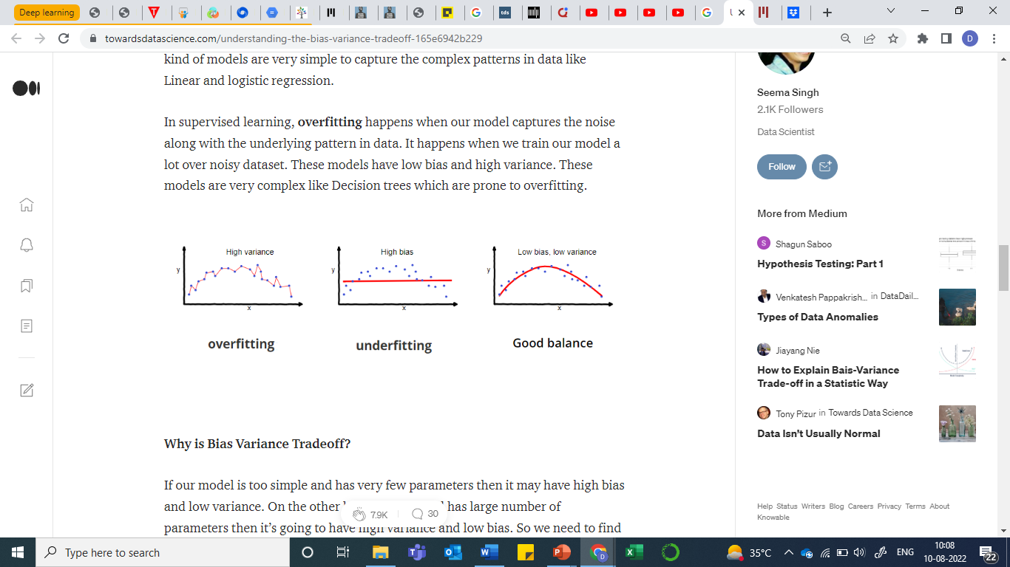
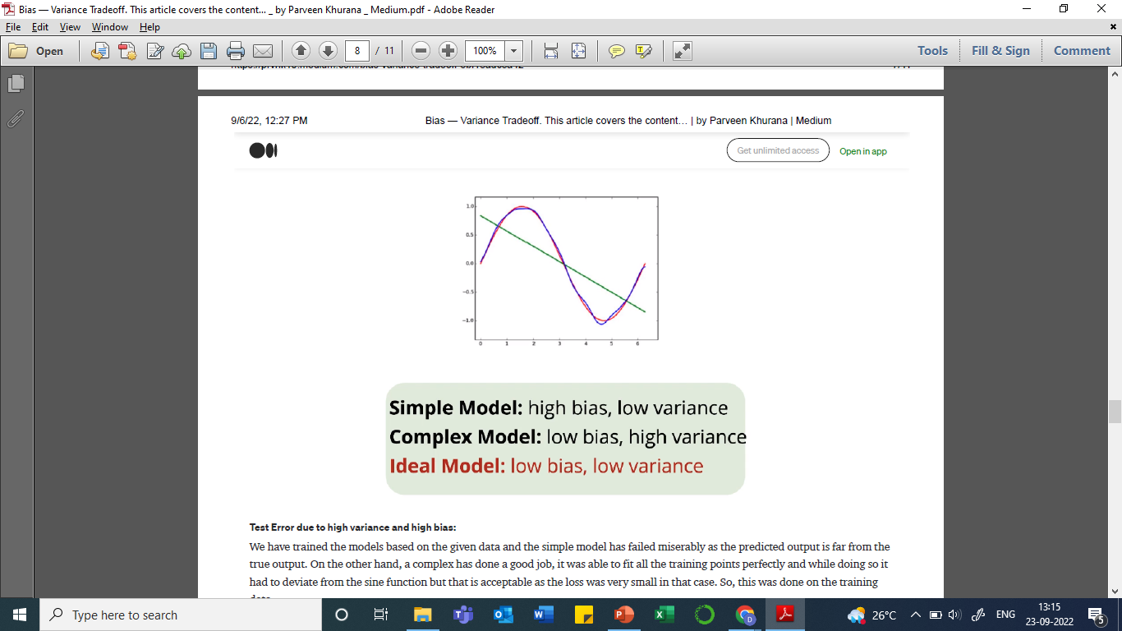
Bias vs Variance

Slide 22
Bias at Data level

Slide 23
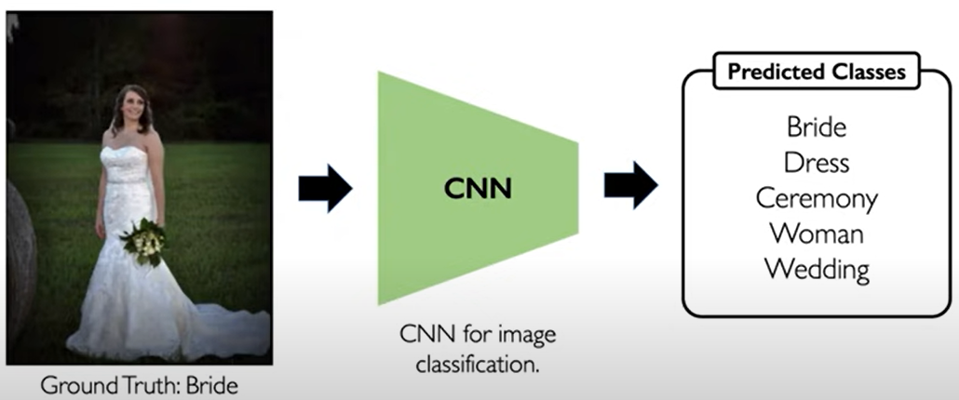
Bias in image classification
Notes:
Lets say our CNN model is trained on a bunch of open source of images, and for this given image, it predicts classes like bride, dress, ceremony, woman, and wedding, which is expected.

Slide 24
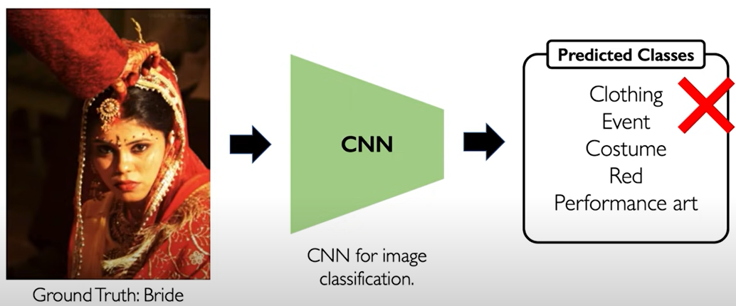
Bias in image classification
Notes:
Now lets say after training this image is given, and predicted classes are clothing, red, art, etc. but none is related to bride. SO it shows that while training there was a bias in the data set, may be the data set on which the model is trained contained only the bridal images from one part of the world where may be only Christian brides are there, and thus the model is unable to characterize this image well.

Slide 25
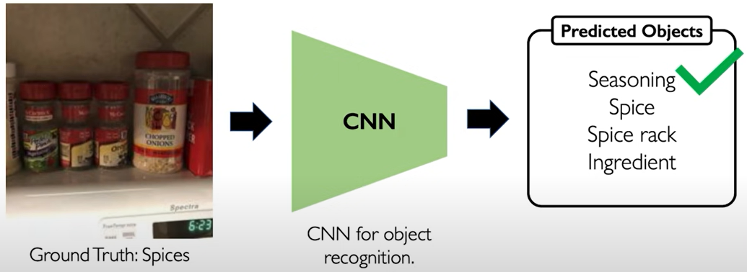
Bias in object recognition
Notes:
CNN trained on images from north America for object recognition task.

Slide 26
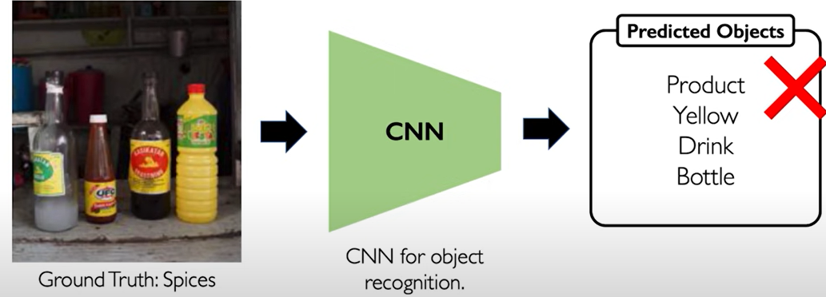
Bias in object recognition
Notes:
CNN tested on images collected from other parts of the world for the object recognition task. And clearly, the results are not as expected.

Slide 27
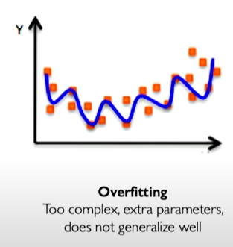
Summary
Overfitting
Regularization
Bias and Variance

Slide 28
References
MIT Introduction to Deep Learning | 6.S191 by Alexander Amini
https://www.youtube.com/watch?v=7sB052Pz0sQ&list=PLtBw6njQRU-rwp5__7C0oIVt26ZgjG9NI
MIT 6.S191: AI Bias and Fairness
https://www.youtube.com/watch?v=wmyVODy_WD8

